Slide 1
2016 US Primaries
Demographics analysis.
DRAFT

Slide 2
Agenda
Team
Problem statement & meeting purpose
Data overview
Gaps reconciliation
Results
Conclusions
Recommendations

Slide 3
Team

Slide 4
Background & Meeting Purpose
Team was given a task to analyze demographics impact on 2016 US Primary elections.
Primary elections, often abbreviated to primaries, are a process by which voters can indicate their preference for their party's candidate, or a candidate in general, in an upcoming general election, local election, or by-election.
Team analyzed correlation between a number of social factors and Republican vs Democrat vote ratio.
Purpose of the meeting is to get board concurrence with presented recommendations.

Slide 5
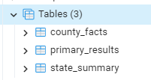
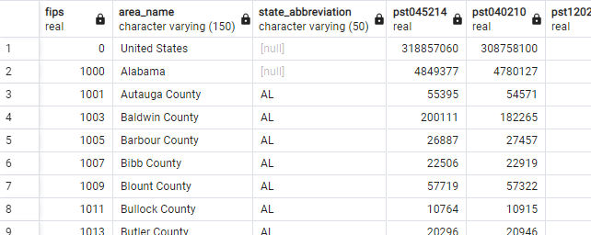
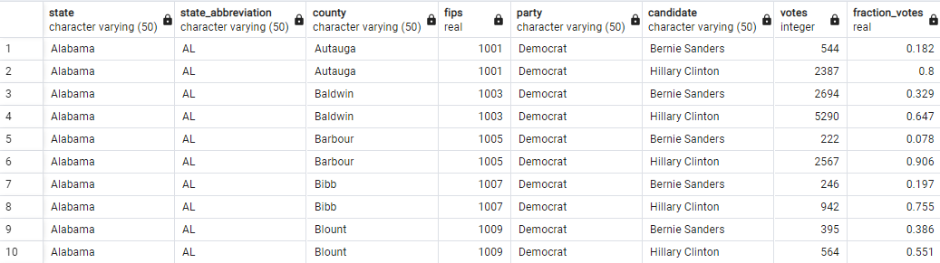
Data overview
Source data consists of 3 tables:
County_Facts - List of Demographics Stats presented as percent and absolute values for States and Counties
County_Facts_Dictionary - Description of Demographics Stats
Primary_Results - Number of votes for Republican and Democrat candidates presented for each State and County
For simplicity data is gathered and post processed to show only Republican vs Democrat voters and aggregated for States.
Data was post processed to show Republican vs Democrat voters to draw conclusions.

Slide 6
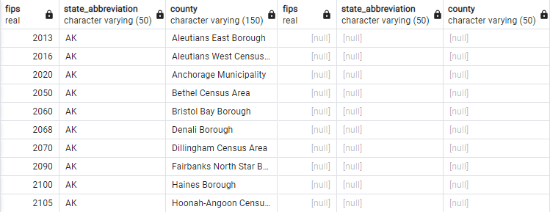
Gaps reconciliation
Counties that don’t have voting data.
There are 345 counties presented in County_Facts that are not reflected in Primary_Results. There is no voting data for 345 counties.
There are 1419 counties presented in Primary_Results that are not reflected in County_Facts. There are no demographics stats for 1419 counties with voting data.
Analysis shows that gaps represent ~11% of missing county facts, that are used for analysis.
Gaps do not follow any pattern and do not adversely affect the statistical significance of conclusions.
Gaps do not have an appreciable impact on conclusions and recommendations.

Slide 7
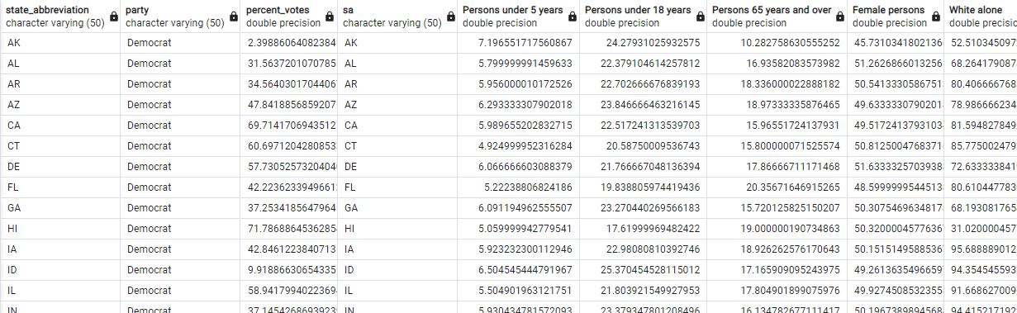
Results
Demographic facts are presented as % value per state for selected stats.
State_abbrevitaion joins primary results and demographics
Percent_votes are displayed in relation to Democrat votes, Republican votes are 1-Democrat
Percent votes are related to Democrat votes, which represent Democrat/Republican vote ratio.

Slide 8
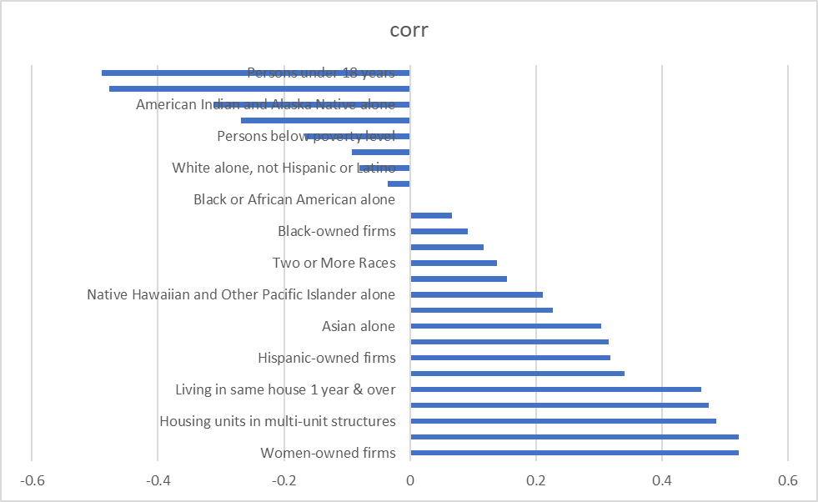
Results
Biggest pro democrat correlation is with % of people of color, living conditions and women empowerment. Surprisingly native american population tend to vote red. This might be correlated with gambling industry which is tax averse.

Slide 9
Conclusions
Democrat votes have strongest correlations with women owned firearms and housing conditions.
Republican votes have strongest correlation with % of young people, native americans, white people
Best course of action would be to target swing states with stats that are most in line with the observed correlation
Biggest pro democrat correlation is with % of people of color, living conditions and women empowerment. Surprisingly native american population tend to vote red, which might be correletad with gambling industry for which republican present more lax attitude.

Slide 10
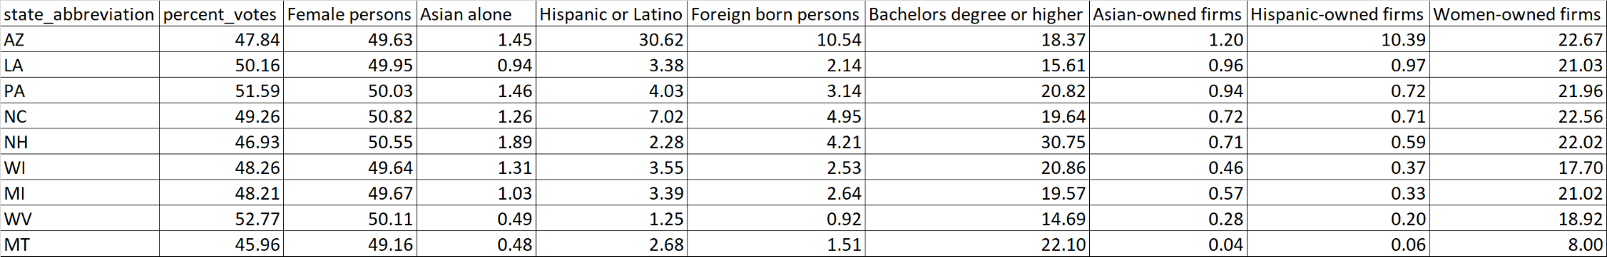
Recommendations
Team recommendation is to target states where voter gap is easiest to close, and which have indicators correlating with Democrat majority states. See list below.
Target states, where it’s easiest to win votes and the gap to close is below 5pp.

